Slide 1
RENAL AND GENITOURINARY NURSING

Slide 2
History taking and patient assessment
It is important to obtain a comprehensive health history which includes assessment of risk factors in a patient with upper or lower urinary tract dysfunction.
Data about previous health problems or diseases provides the healthcare team with useful information for evaluating the patient’s current urinary status.

Slide 3
Health history
Obtaining a Urologic health history requires excellent communication skills because many patients are embarrassed or uncomfortable discussing genitourinary function or symptoms.
Use simple language that a patient understands avoid medical jargons.

Slide 4
When obtaining health history, the Nurse should enquire about the following;
The patient’s chief concern or reason for seeking health care, the onset of the problem and its effect on patient’s quality of life
The location, character and duration of pain if present and its relationship to voiding, factors that precipitate pain, and those that relieve it.

Slide 5
Cont.
History of urinary tract infections including past treatment or hospitalization for any Urinary tract infection.
Fever or chills
Previous renal or urinary diagnostic tests or use of indwelling urinary catheters.
Dysuria and when it occurs during voiding (at initiation or termination of voiding)

Slide 6
Cont.
Hesitancy, straining or pain during or after urination
Urinary incontinence (stress incontinence, urge incontinence overflow incontinence or functional incontinence)
Haematuria or change in colour or volume of urine
Nocturia and its date of onset.
Renal calculi (Kidney stones) passage of stones or gravel in urine

Slide 7
Female patients
Number and type (Vaginal or Caesarean) of deliveries
Use of forceps, vaginal infections, discharge or irritation, contraceptive practices
Presence or history of genital lesions or sexually transmitted diseases
Habits; use of tobacco, alcohol or recreational drugs
Any prescription and over the counter medications including those prescribed for renal or urinary problems

Slide 8
Gerontologic considerations
A thorough medication history is important for elderly patients for whom the increased occurrence of chronic illness often necessitates polypharmacy (Concurrent use of multiple medications)
Aging affects the way the body absorbs, metabolizes and excretes drugs thus placing the elderly patients at risk for adverse reactions including compromised renal function.

Slide 9
Cont.
Other key information includes an assessment of patient’s psychosocial status level of anxiety, perceived threats to body image.
Obtaining this information during initial and subsequent nursing assessment enables the nurse to detect special needs, misunderstandings, lack of knowledge and need for patient teaching.
Pain, changes in voiding and gastrointestinal symptoms (Nausea and vomiting) are particularly suggestive of urinary tract disease.

Slide 10
Cont.
Gradual kidney dysfunction can be insidious in its presentation although fatigue is a common symptom, fatigue, shortness of breath and exercise intolerance all result from a condition known as anaemia of chronic disease

Slide 11
URINARY SYSTEMS TESTS
Urinalysis and Urine culture
The urinalysis provides important clinical information on kidney function and helps diagnose other diseases like diabetes.
The urine culture determines if bacteria are present in urine as well as their strains and concentration. Urine culture and sensitivity also identify the antimicrobial therapy that is best suited for the particular strains identified.

Slide 12
Urine examination includes the following;
Urine colour
Urine clarity and odour
Urine pH and specific gravity
Tests to detect protein, glucose, and ketone bodies in urine
Microscopic examination of urine

Slide 13
Blood Urea Nitrogen & Creatinine
End products of protein metabolism excreted by kidneys
BUN 10 – 20mg/dl
Creatinine 0.7 – 1.4mg/dl
Elevated BUN reflects reduced renal perfusion (Decreased cardiac output, or intravascular fluid volume deficit (dehydration, diuretic therapy)

Slide 14
Creatinine.
Is a waste product produced by muscles from breakdown of a compound called Creatine (Recycling of ATP).
Ranges: adult men – 0.74 – 1.35mg/dl (65.4-119.3 micromoles/l)
Adult women – 0.59 – 1.04mg/dl (52.2-91.9 micromoles/l)

Slide 15
Creatine
Is an organic acid that helps to supply energy to cells particularly muscle cells
It is higher in men than women due to body size and muscle mass

Slide 16
Electrolytes
Minerals in body that have an electric charge ( found in blood, tissues and other body fluids.
They dissociate in solution and have the ability to conduct an electrical current.
Sodium, Calcium, Potassium, Chloride, Phosphate and magnesium.

Slide 17
Major electrolytes
Sodium major cation - ECF (136 – 146mEq/l)
Potassium major cation - ICF (3.5 -4.5mEq/l)
Chloride major anion (96 – 106mmol/l)

Slide 18
Functions of electrolytes
Body water balance
Balance body’s acid/base (pH) level
Move nutrients into cells
Move wastes out of cells

Slide 19
Urine analysis
Routine urine analysis (Urinalysis) includes chemical analysis to detect
Protein
Sugar
Ketones

Slide 20
A urine test can include three parts:
Visual exam. The urine will be looked at for colour and clearness.
Blood may make urine look red or the colour of tea or cola.
An infection may make urine look cloudy.
Foamy urine can be a sign of kidney problems.

Slide 21
Microscopic exam.
A small amount of urine will be looked at under a microscope to check for:
Red blood cells
White blood cells (or pus cells)
Bacteria (germs), or crystals (which are formed from chemicals in the urine and may eventually get bigger and become kidney stones).

Slide 22
Dipstick test.
A dipstick is a thin, plastic stick with strips of chemicals on it.
It is dipped into the urine.
The strips change colour if a substance is present at a level that is above normal.

Slide 23
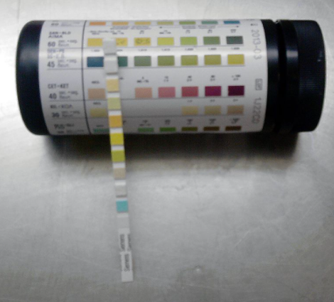
Multistix

Slide 24
Acidity (pH)
Is a measure of the amount of acid in the urine.
A pH that is above normal may be a sign of kidney stones,
Urinary infections,
Kidney problems, or other disorders.

Slide 25
Cont.
And microscopic examination to detect Red and White blood cells
Tests can be simply and inexpensively performed at the bedside office and can detect level of variety of substances in the urine

Slide 26
Cont.
A thin strip of plastic (dipstick) impregnated with chemicals that react with substances in the urine and change colour
Protein
(Proteinuria) is a sign of kidney disease but may occur often strenuous exercise such as marathon running

Slide 27
Glucose
(Sugar) in the urine (Glycosuria) can be detected by dipstick (very accurate) The most common cause is diabetes.
If blood glucose is normal but appear in urine- kidney abnormality is probably the problem

Slide 28
Ketones
In the urine (Ketonuria) Ketones are formed when the body breaks down fat.
Starvation, uncontrolled diabetes and alcohol intoxication can produce ketones in urine.
Nitrates
In urine (Nitrituria) are also detectable by dipstick. Nitrite levels increase when bacteria are present.
This test is used to diagnose infection quickly

Slide 29
Leukocyte esterase
An enzyme found in certain WBC’s in urine
It is a sign of inflammation mostly caused by bacterial infection
False negative results – urine concentrated or contains glucose, bile salts, antibiotics rifampicin or vitamin C

Slide 30
Obtaining a clean-catch urine sample
Head of a man’s penis or opening of a woman’s urethra is washed.
First few drops of urine are allowed to flow into the toilet washing out the urethra
Urination is resumed and a sample is collected from the stream into a sterile cup.

Slide 31
Intravenous urography
Is an X-ray technique used to display the kidneys and lower urinary tract.
A radiopaque substance (radio contrast) which can be seen on x-rays is given intravenously. It gets concentrated in the kidneys in less than 5 minutes then an x-ray film is taken.
It provides a picture of the kidneys and passage of radiopaque substance through the ureter into the urinary bladder.
Sudden kidney failure occurs as an adverse effect in 1 out of 20 cases.

Slide 32
Reasons for adverse effects are unknown- Risk is higher in those who are:
Elderly
Have prior kidney insufficiency
Diabetes Mellitus
Dehydration
Multiple Myeloma

Slide 33
Cystography
An x-ray image of the bladder is obtained as part of the intravenous urography
Retrograde cystogram is produced when radiopaque substance is introduced through the urethra
It provides more information about Urinary bladder and ureter
X-ray films are taken before, during and after urination.

Slide 34
Cystoscopy
A fibre optic viewing device is threaded up through the urethra to view the bladder
Can be used to get biopsies or removal of growths or tumours

Slide 35
DISORDERS OF THE KIDNEYS
Pyelonephritis
Is a bacterial infection of the renal pelvis, tubules, and interstitial tissue of one or both kidneys.
Causes
Involve either the upward spread of bacteria from the bladder
Spread from systemic sources reaching the kidney via the bloodstream.

Slide 36
Causes
Pathogenic bacteria from a bladder infection can ascend into the kidney, resulting in pyelonephritis.
An incompetent ureterovesical valve or obstruction occurring in the urinary tract increases the susceptibility of the kidneys to infection because static urine provides a good medium for bacterial growth

Slide 37
Cont.
Pyelonephritis may be acute or chronic.
Acute pyelonephritis
manifested by enlarged kidneys with interstitial infiltrations of inflammatory cells.
Abscesses may be noted on or within the renal capsule and at the corticomedullary junction.
Eventually, atrophy and destruction of tubules and the glomeruli may result.

Slide 38
Cont.
When pyelonephritis becomes chronic
The kidneys become scarred
Contracted
Non-functioning.
Chronic pyelonephritis is a cause of chronic kidney disease that can result in the need for renal replacement therapies such as transplantation or dialysis

Slide 39
ACUTE PYELONEPHRITIS
Clinical Manifestations
Is acutely ill with chills
Fever
Leukocytosis, bacteriuria, and pyuria.
Low back pain
flank pain
Nausea and vomiting
headache,

Slide 40
Cont.
Malaise
painful urination are common findings.
Physical examination reveals pain and tenderness in the area of the costovertebral angle.
Symptoms of lower urinary tract involvement, such as urgency and frequency, are common

Slide 41
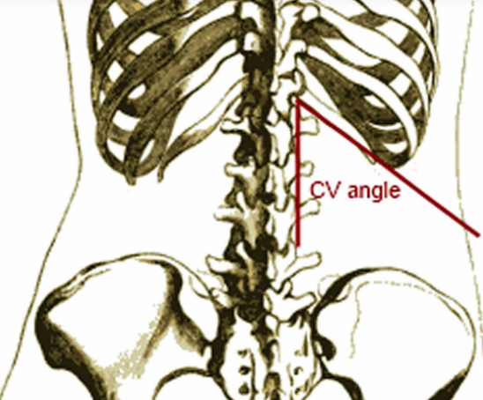
Costovertebral angle

Slide 42
Assessment and Diagnostic Findings
An ultrasound study or a CT scan may be performed to locate any obstruction in the urinary tract.
Relief of obstruction is essential to prevent the complications and eventual kidney damage.
An IV pyelogram may be indicated with pyelonephritis if functional and structural renal abnormalities are suspected.

Slide 43
Assessment cont.
Radionuclide imaging with gallium citrate and indium-111 (111In)– labelled WBCs may be useful to identify sites of infection that may not be visualized on CT scan or ultrasound.
Urine culture and sensitivity tests are performed to determine the causative organism so that appropriate antimicrobial agents can be prescribed.

Slide 44
Medical Management
Patients with acute uncomplicated pyelonephritis are most often treated on an outpatient basis if they are not exhibiting:
Dehydration
Nausea or vomiting
Symptoms of sepsis.
In addition, they must be responsible and reliable to ensure that all medications will be taken as prescribed.

Slide 45
Med mnx. Cont.
Out patients, a 2-week course of antibiotics is recommended because renal parenchymal disease is more difficult to eradicate than mucosal bladder infections.
Commonly prescribed agents include same medications prescribed for the treatment of UTIs.

Slide 46
Cont.
Pregnant women may be hospitalized for 2 or 3 days of parenteral antibiotic therapy.
Oral antibiotic agents may be prescribed once the patient is afebrile and showing clinical improvement.

Slide 47
Cont.
A possible issue in acute pyelonephritis treatment is a chronic or recurring symptomless infection persisting for months or years.
After the initial antibiotic regimen, the patient may need antibiotic therapy for up to 6 weeks if a relapse occurs.

Slide 48
Cont.
A follow-up urine culture is obtained 2 weeks after completion of antibiotic therapy to document clearing of the infection.
Hydration with oral or parenteral fluids is essential in all patients with UTIs when there is adequate kidney function.
Hydration helps facilitate “flushing” of the urinary tract and reduces pain and discomfort.

Slide 49
CHRONIC PYELONEPHRITIS
Repeated bouts of acute pyelonephritis may lead to chronic pyelonephritis.
Clinical Manifestations
The patient with chronic pyelonephritis usually has no symptoms of infection unless an acute exacerbation occurs.

Slide 50
Ssx.
Noticeable signs and symptoms may include:
fatigue
Headache
poor appetite
Polyuria
excessive thirst, and weight loss

Slide 51
Cont.
Persistent and recurring infection may produce progressive scarring of the kidney, resulting in renal failure.
Assessment and Diagnostic Findings
IV urogram
measurements of creatinine clearance

Slide 52
Dx. cont
Blood urea nitrogen
Creatinine levels.
Bacteria, if detected in the urine, are eradicated if possible

Slide 53
Complications
Include end-stage renal disease (from progressive loss of nephrons secondary to chronic inflammation and scarring)
Hypertension
formation of kidney stones (from chronic infection with urea-splitting organisms)

Slide 54
Medical Management
Long-term use of prophylactic antimicrobial therapy may help limit recurrence of infections and renal scarring.
Impaired renal function alters the excretion of antimicrobial agents and necessitates careful monitoring of renal function, especially if the medications are potentially toxic to the kidneys

Slide 55
Nursing Management
The patient may require hospitalization or may be treated as an outpatient.
If a patient requires hospitalization
fluid intake and output are carefully measured and recorded.
Unless contraindicated, 3 to 4 L of fluids per day is encouraged to dilute the urine, decrease burning on urination, and prevent dehydration.

Slide 56
Nursing care
The nurse assesses the patient’s temperature every 4 hours
administers antipyretic and antibiotic agents as prescribed.
Symptomatic patients are often more comfortable on bed rest.

Slide 57
Patient teaching
focuses on prevention of further infection by consuming adequate fluids
emptying the bladder regularly
and performing recommended perineal hygiene.
The importance of taking antimicrobial medications exactly as prescribed is stressed,
need for keeping follow-up appointments

Slide 58
RENAL FAILURE
Results when the kidneys cannot remove the body’s metabolic wastes or perform their regulatory functions.
The substances normally excreted in urine accumulate in the body fluids as a result of impaired renal excretion
Affecting endocrine and metabolic functions as well as fluid, electrolyte, and acid–base disturbances.

Slide 59
Cont.
Renal failure is a systemic disease and is a final common pathway of many different kidney and urinary tract diseases.

Slide 60
Acute renal failure (ARF) CKD.
Is a rapid loss of renal function due to damage to the kidneys.
Potentially life-threatening metabolic complications can occur, including metabolic acidosis & fluid and electrolyte imbalances.

Slide 61
Cont.
Treatment is aimed at:
Replacing renal function temporarily to minimize potentially lethal complications
Reduce potential causes of increased renal injury with the goal of minimizing long-term loss of renal function.

Slide 62
Cont.
A widely accepted criterion for ARF is a 50% or greater increase in serum creatinine above baseline (normal creatinine is less than 1.0 mg/dL).

Slide 63
AKD Cont.
Urine volume may be normal, or changes may occur.
Possible changes include:
Oliguria (less than 500 mL/day)
Non-oliguria (greater than 800 mL/day)
Anuria (less than 50 mL/day)

Slide 64
Pathophysiology
Pathogenesis of ARF and oliguria is not always known, many times there is a specific underlying problem.
Conditions that reduce blood flow to the kidney and impair kidney function:
Hypovolemia
Hypotension

Slide 65
Cont.
(3) Reduced cardiac output and heart failure
(4)Obstruction of the kidney or lower urinary tract by tumour, blood clot, or kidney stone
(5) Bilateral obstruction of the renal arteries or veins.
If these conditions are treated and corrected before the kidneys are permanently damaged, the increased BUN and creatinine levels, oliguria, and other signs may be reversed.

Slide 66
Cont
Renal stones are not a common cause of ARF, some types may increase the risk for ARF.
Primary struvite stones, and infection-related urolithiasis associated with anatomic and functional urinary tract anomalies
Spinal cord injury may cause recurrent bouts of obstruction as well as crystal specific damage to tubular epithelial cells and interstitial renal cells.

Slide 67
Categories of Acute Renal Failure
Pre-renal (hypoperfusion of kidney)
Intrarenal (actual damage to kidney tissue)
Post-renal (obstruction to urine flow).
Pre-renal ARF, which occurs in 60% to 70% of cases, is the result of impaired blood flow that leads to hypoperfusion of the kidney and a decrease in the GFR. Intrarenal ARF is the result of actual

Slide 68
Cont.
parenchymal damage to the glomeruli or kidney tubules.
Acute tubular necrosis (ATN) is the most common type of intrinsic ARF.
Characteristics of ATN are:
Intratubular obstruction
Tubular back leak (abnormal reabsorption of filtrate and decreased urine flow through the tubule)

Slide 69
Cont.
Vasoconstriction, and changes in glomerular permeability.
These processes result in
Decrease of GFR
Progressive azotemia (Elevated levels of urea and other compounds in the blood)
Fluid and electrolyte imbalances.

Slide 70
Cont.
CKD, diabetes, heart failure, hypertension, and cirrhosis can lead to ATN.
Postrenal ARF usually results from obstruction distal to the kidney.

Slide 71
Causes of Acute Renal Failure
Pre-renal Failure
Volume depletion resulting from:
Haemorrhage Renal losses (diuretics, osmotic diuresis)
Gastrointestinal losses (vomiting, diarrhoea, nasogastric suction)
Impaired cardiac efficiency resulting from: Myocardial infarction, Heart failure, Dysrhythmias, Cardiogenic shock

Slide 72
Cont.
Vasodilation resulting from:
Sepsis
Anaphylaxis (Acute allergic reaction to an antigen eg. Bee sting)
Antihypertensive medications or other medications that cause vasodilation

Slide 73
Intra-renal Failure
Prolonged renal ischemia resulting from:
Pigment nephropathy (associated with the breakdown of blood cells containing pigments that in turn occlude kidney structures)
Myoglobinuria (trauma, crush injuries, burns)
Haemoglobinuria (transfusion reaction, hemolytic anaemia)

Slide 74
Cont.
Nephrotoxic agents such as:
Aminoglycoside antibiotics (gentamicin, tobramycin)
Radiopaque contrast agents
Heavy metals (lead, mercury)
Solvents and chemicals (ethylene glycol, carbon tetrachloride, arsenic)

Slide 75
Cont.
Nonsteroidal anti-inflammatory drugs (NSAIDs)
Angiotensin-converting enzyme inhibitors (ACE inhibitors)
Infectious processes such as: Acute pyelonephritis Acute glomerulonephritis

Slide 76
Post-renal Failure
Urinary tract obstruction, including:
Calculi (stones)
Tumours Benign prostatic hyperplasia
Strictures
Blood clots

Slide 77
Phases of Acute Renal Failure
Four phases of ARF:
Initiation
Oliguria
Diuresis
Recovery.

Slide 78
Cont.
The initiation period begins with the initial insult and ends when oliguria develops.
The oliguria period is accompanied by an increase in the serum concentration of substances usually excreted by the kidneys (urea, creatinine, uric acid, organic acids, and the intracellular cations [potassium and magnesium]).

Slide 79
Cont.
The minimum amount of urine needed to rid the body of normal metabolic waste products is 400 ml.
In this phase uremic symptoms first appear and life-threatening conditions such as hyperkalemia develop.

Slide 80
Cont.
The diuresis period is marked by:
Gradual increase in urine output, which signals that glomerular filtration has started to recover.
Laboratory values stabilize and eventually decrease.
Although the volume of urinary output may reach normal or elevated levels, renal function may still be markedly abnormal.

Slide 81
Cont.
Uremic symptoms may still be present, the need for expert medical and nursing management continues.
The patient must be observed closely for dehydration during this phase; if dehydration occurs, the uremic symptoms are likely to increase.

Slide 82
Cont.
The recovery period
Signals the improvement of renal function and may take 3 to 12 months.
Laboratory values return to the patient’s normal level.
Although a permanent 1% to 3% reduction in the GFR is common, it is not clinically significant.

Slide 83
Clinical Manifestations
Almost every system of the body is affected with failure of the normal renal regulatory mechanisms.
The patient may appear critically ill and lethargic.
The skin and mucous membranes are dry from dehydration.

Slide 84
Cont.
Central nervous system signs and symptoms include:
Drowsiness
Headache
muscle twitching
seizures.

Slide 85
Assessment and Diagnostic Findings
Assessment of the patient with ARF includes evaluation for changes in
the urine
diagnostic tests that evaluate the kidney contour, and a variety of laboratory values.

Slide 86
In ARF
Urine output varies from scanty to a normal volume
Haematuria may be present
Urine has a low specific gravity (compared with a normal value of 1.010 to 1.025).

Slide 87
In ARF
Urine output varies from scanty to a normal volume
Haematuria may be present
Urine has a low specific gravity (compared with a normal value of 1.010 to 1.025).

Slide 88
Cont.
One of the earliest manifestations of tubular damage is the inability to concentrate the urine.
Patients with pre-renal azotemia have a decreased amount of sodium in the urine (less than 20 mEq/L) and normal urinary sediments.

Slide 89
Cont.
Patients with intra-renal azotemia usually have urinary sodium levels greater than 40 mEq/L with urinary casts and other cellular debris.
Ultrasonography scan may show evidence of anatomic changes.

Slide 90
Cont
The BUN level increases steadily at a rate dependent on the degree of catabolism (breakdown of protein), renal perfusion, and protein intake.
Serum creatinine levels are useful in monitoring kidney function and disease progression and increase with glomerular damage.

Slide 91
Cont.
With a decline in the GFR, oliguria, and anuria, patients are at high risk for hyperkalemia.
Protein catabolism results in the release of cellular potassium into the body fluids, causing severe hyperkalemia (high serum potassium levels).
Hyperkalemia may lead to dysrhythmias, such as ventricular tachycardia and cardiac arrest.

Slide 92
Cont.
Sources of potassium include:
normal tissue catabolism
dietary intake
blood in the GI tract, or blood transfusion
other sources (eg, IV infusions, potassium penicillin, and extracellular shift in response to metabolic acidosis).

Slide 93
Cont.
Progressive metabolic acidosis occurs in renal failure because patients cannot eliminate the daily metabolic load of acid-type substances produced by the normal metabolic processes.
In addition, normal renal buffering mechanisms fail. This is reflected by a decrease in the serum CO2- combining power and blood pH.

Slide 94
Cont.
There may be an increase in blood phosphate concentrations
Calcium levels may be low due to decreased absorption of calcium from the intestine and as a compensatory mechanism for the elevated blood phosphate levels.

Slide 95
Cont.
Anaemia is another common laboratory finding in ARF, as a result of:
reduced erythropoietin production
uremic GI lesions
reduced RBC lifespan
blood loss from the GI tract.

Slide 96
Prevention
ARF has a high mortality rate that ranges from 25% to 90%.
Factors that influence mortality include:
increased age,
comorbid conditions
pre-existing renal and vascular diseases.
A careful history is obtained to identify exposure to nephrotoxic agents or environmental toxins.

Slide 97
Cont.
Kidneys are susceptible to the adverse effects of medications because they are repeatedly exposed to substances in the blood.
Patients taking nephrotoxic medications eg.
Aminoglycosides
Gentamicin
tobramycin, colistimethate, polymyxin B, amphotericin B, vancomycin, amikacin, cyclosporine) should be monitored closely for changes in renal function.

Slide 98
Cont.
BUN and serum creatinine levels should be obtained:
at baseline within 24 hours after initiation of these medications
and at least twice a week while the patient is receiving them

Slide 99
Cont.
Provide adequate hydration to patients at risk for dehydration including: Before, during, and after surgery
Patients undergoing intensive diagnostic studies requiring fluid restriction and contrast agents (eg, barium enema, intravenous pyelograms)

Slide 100
Cont.
Especially elderly patients who may have marginal renal reserve Patients with neoplastic disorders or disorders of metabolism (eg, gout) and those receiving chemotherapy
2. Prevent and treat shock promptly with blood and fluid replacement.
3. Monitor central venous and arterial pressures and hourly urine output of critically ill patients to detect the onset of renal failure as early as possible.

Slide 101
Cont.
4. Treat hypotension promptly.
5. Continually assess renal function (urine output, laboratory values) when appropriate.
6. Take precautions to ensure that the appropriate blood is administered to the correct patient in order to avoid severe transfusion reactions, which can precipitate renal failure.

Slide 102
Cont.
7. Prevent and treat infections promptly. Infections can produce progressive renal damage.
8. Pay special attention to wounds, burns, and other precursors of sepsis.

Slide 103
Cont.
9. To prevent infections from ascending in the urinary tract, give meticulous care to patients with indwelling catheters. Remove catheters as soon as possible.
10. To prevent toxic drug effects, closely monitor dosage, duration of use, and blood levels of all medications metabolised or excreted by the Kidneys.

Slide 104
Medical Management
Objectives of treatment of ARF are to:
Restore normal chemical balance
Prevent complications until repair of renal tissue
and restoration of renal function can occur.

Slide 105
Management includes
Eliminating the underlying cause
Maintaining fluid balance
Avoiding fluid excesses
when indicated, providing renal replacement therapy

Slide 106
Mnx. Cont.
Pre-renal azotaemia is treated by:
optimizing renal perfusion
Post-renal failure is treated by:
relieving the obstruction.

Slide 107
Mnx cont.
Intrarenal azotemia is treated with
Supportive therapy
Removal of causative agents
Aggressive management of pre-renal and postrenal failure, and avoidance of associated risk factors. Shock and infection, if present, are treated promptly

Slide 108
Maintenance of fluid balance is based on:
Daily body weight
Serial measurements of central venous pressure
Serum and urine concentrations
Fluid losses
Blood pressure

Slide 109
Cont.
The clinical status of the patient.
The parenteral and oral intake and the output of urine
Gastric drainage
Stools
Wound drainage
and perspiration are calculated and are used as the basis for fluid replacement.

Slide 110
Cont.
The insensible fluid produced through the normal metabolic processes and lost through the skin and lungs is also considered in fluid management
Fluid excesses can be detected by the clinical findings of
Dyspnoea
Tachycardia
Distended neck veins.

Slide 111
Cont.
The patient’s lungs are auscultated for moist crackles.
Because pulmonary Oedema may be caused by excessive administration of parenteral fluids, extreme caution must be used to prevent fluid overload.
The development of generalized oedema is assessed by examining the pre-sacral and pretibial areas several times daily. Mannitol (Osmitrol), furosemide (Lasix), or ethacrynic acid (Edecrin) may be prescribed to initiate diuresis.

Slide 112
Cont.
Adequate renal blood flow in patients with pre-renal causes of ARF may be restored by:
IV fluids
Transfusions of blood products.
If ARF is caused by hypovolemia secondary to hypoproteinemia:
an infusion of albumin may be prescribed.
.

Slide 113
Cont.
Dialysis may be initiated to prevent complications of ARF, such as:
Hyperkalemia
Metabolic acidosis
Pericarditis
Pulmonary Oedema.

Slide 114
Hemodialysis (a procedure that circulates the patient’s blood through a dialyzer to remove waste products and excess fluid)
Peritoneal dialysis (PD) (a procedure that uses the patient’s peritoneal membrane [the lining of the peritoneal cavity] as the semipermeable membrane to exchange fluid and solutes), or a variety of continuous renal replacement therapies (CRRTs)

Slide 115
Pharmacologic Therapy
Hyperkalaemia is the most life-threatening of the fluid and electrolyte changes that occur in patients with renal disturbances.
The patient is monitored for hyperkaelemia through serial serum electrolyte levels (potassium value greater than 5.0 mEq/L [5 mmol/L])
ECG changes (tall, tented, or peaked T waves)
Changes in clinical status.

Slide 116
Other symptoms of hyperkalaemia include:
Irritability
abdominal cramping
Diarrhoea
Paresthesia
and generalized muscle weakness.

Slide 117
Cont
Muscle weakness may present as:
slurred speech
difficulty breathing
paresthesia and paralysis.
As the potassium level increases, both cardiac and other muscular function declines, making this a true medical emergency.

Slide 118
Med mnx.
The elevated potassium levels may be reduced by administering cation-exchange resins (sodium polystyrene sulfonate [Kayexalate]) orally or by retention enema.
Kayexalate works by exchanging sodium ions for potassium ions in the intestinal tract.
Sorbitol may be administered in combination with Kayexalate to induce a diarrhoea

Slide 119
If the patient is hemodynamically unstable (low blood pressure, changes in mental status, dysrhythmia)
IV dextrose 50%
Insulin, and calcium replacement may be administered to shift potassium back into the cells.
Albuterol sulfate (Ventolin HFA) by nebulizer can lower plasma potassium concentration by 0.5 to 1.5 mEq/L.

Slide 120
The shift of potassium into the intracellular space is temporary, so arrangements for dialysis need to be made on an emergent basis.
Since many medications are eliminated through the kidneys, dosages must be reduced when a patient has ARF.

Slide 121
Examples of commonly used agents that require adjustment are:
antibiotic medications (especially aminoglycosides),
Digoxin
ACE inhibitors
magnesium-containing agents

Slide 122
Diuretic agents are often used to control fluid volume, but they have not been shown to improve recovery from ARF.
In patients with severe acidosis, the arterial blood gases and serum bicarbonate levels (CO2-combining power) must be monitored because the patient may require sodium bicarbonate therapy or dialysis.

Slide 123
If respiratory problems develop, appropriate ventilatory measures must be instituted.
The elevated serum phosphate level may be controlled with phosphate-binding agents (eg, calcium or lanthanum carbonate) that help prevent a continuing rise in serum phosphate levels by decreasing the absorption of phosphate from the intestinal tract

Slide 124
Nutritional Therapy
ARF causes severe nutritional imbalances due to:
Nausea and vomiting (contribute to inadequate dietary intake)
Impaired glucose use and protein synthesis
Increased tissue catabolism.

Slide 125
Cont.
The patient is weighed daily and loses 0.2 to 0.5 kg (0.5 to 1 lb) daily if the nitrogen balance is negative (ie, caloric intake falls below caloric requirements).
If the patient gains or does not lose weight or develops hypertension, fluid retention should be suspected.

Slide 126
Nutritional support is based on the
Underlying cause of ARF
The catabolic response
The type and frequency of renal replacement therapy
Comorbidities
Nutritional status.

Slide 127
Replacement of dietary proteins is individualized to provide the maximum benefit and minimize uremic symptoms

Slide 128
Caloric requirements are met with high-carbohydrate meals, because carbohydrates have a protein-sparing effect (ie, in a high-carbohydrate diet
Protein is not used for meeting energy requirements but is “spared” for growth and tissue healing).
Foods and fluids containing potassium or phosphorus (eg, bananas, citrus fruits and juices, coffee) are restricted

Slide 129
Nursing Management
The nurse:
Monitors for complications
Participates in emergency treatment of fluid and electrolyte imbalances, assesses the patient’s progress and response to treatment
Provides physical and emotional support.

Slide 130
The nurse keeps family members informed about the patient’s condition
Helps them understand the treatments,
Provides psychological support.
Although the development of ARF may be the most serious problem, the nurse continues to provide nursing care indicated for the primary disorder (eg, burns, shock, trauma, obstruction of the urinary tract).

Slide 131
Monitoring Fluid and Electrolyte Balance
The nurse monitors the patient’s serum electrolyte levels and physical indicators of these complications during all phases of the disorder.
Hyperkalaemia is the most immediate life-threatening imbalance seen in ARF.
Parenteral fluids, all oral intake, and all medications are screened carefully to ensure that hidden sources of potassium are not inadvertently administered or consumed.

Slide 132
IV solutions must be carefully selected based on the patient’s fluid and electrolyte status.
The patient’s cardiac function and musculoskeletal status are monitored closely for signs of hyperkalaemia.

Slide 133
The nurse monitors fluid status by paying careful attention to fluid intake (IV medications should be administered in the smallest volume possible)
Urine output
Apparent Oedema
Distention of the jugular veins
Alterations in heart sounds and breath sounds

Slide 134
Increasing difficulty in breathing.
Accurate daily weights, as well as I&O records, are essential.
Indicators of deteriorating fluid and electrolyte status are reported immediately to the physician, and preparation is made for emergency treatment.
Severe fluid and electrolyte disturbances may be treated with hemodialysis, PD, or CRRT

Slide 135
INTERSTITIAL CYSTITIS (PAINFUL BLADDER SYNDROME)
Definition
Is an inflammatory condition of the bladder wall that is characterised by uncomfortable bladder pressure, bladder pain and sometimes pain in the pelvis.
Cause
Is unknown
Scientists believe that it may be as a result of other bowel conditions such as fibromyalgia or irritable bowel system.

Slide 136
Risk Factors
Age: is diagnosed a 40s
Gender: Is more related to females more than males
Other conditions: Irritable bowel syndrome and fibromyalgia

Slide 137
Clinical manifestations
Severe irritable voiding (day and night frequency, nocturia and urgency)
Painful coitus
Painful urination

Slide 138
Assessment and Diagnostic findings
There is no specific diagnostic test since the symptoms resemble those of other conditions
Doctors have to rule out other treatable conditions before considering a diagnosis of Interstitial Cystitis.
The diagnostic tests that can help rule out other diseases are:
Urinalysis, urine culture, Cystoscopy, biopsy of the bladder walls and urethra.

Slide 139
Medical management
The current treatment is aimed at relieving the symptoms
Pentosan polysulfate sodium (elmiron) 100mg TDS. Repairs the defects that might have developed in the lining of the urinary bladder.
Amitriptyline is a tricyclic antidepressant that helps reduce pain, increase bladder capacity and reduce urinary frequency and urgency.

Slide 140
Electrical nerve stimulation:
Can be used to stimulate the nerves to the bladder.
Can be done over the skin (transcutaneous nerve stimulation) or through an implant.

Slide 141
Surgical procedure:
Bladder cystectomy
Bladder augmentation-enlarging the bladder
Fulguration and resection: Fulguration involves burning of the hunner’s ulcers with electricity or a laser. When the affected area heals, the dead tissues and ulcers fall off and a new tissue grows.
Resection is cutting around and removing the ulcers

Slide 142
Complications
Relationship problems like sexual intimacy
Emotional troubles: Chronic pain and disturbed sleep patterns may cause emotional stress that may lead to depression.
Reduced bladder capacity: This may lead to stiffening of the bladder walls hence reducing the capacity (holds less urine)

Slide 143
Nursing management
Pain Management is assessed to ensure that the medicine is effective.
Encourage patient to implement stress management practices to improve coping techniques
Involve the family in the care of the patient
Provide emotional support to the patient and the family.
Advice on diet. To drink a lot of water and avoid smoking, since it worsens any painful condition and it contributes to bladder cancer.

Slide 144
Cont.
Exercise therapy; easy stretching exercises may help reduce the symptoms.
Teach on bladder training, this will help reduce urinary frequency. This involves going to the toilet according to the clock rather than wait for the need to go. You urinate at set intervals like hourly, whether the urge is there or not. With this the bladder will learn to control the urge to urinate.

Slide 145
HYDRONEPHROSIS
Definition
Is a condition where one or both kidneys become stretched and swollen as a result of build-up of urine inside the kidney(s)
Causes
A blockage: prevent urine from draining out of the kidneys
A reflux: Urine may flow back into the kidneys from the urinary bladder

Slide 146
Pathophysiology
Obstruction to the normal flow of the urine to flow back, resulting in increased pressure in the kidney.
If the obstruction is in the urethra or the bladder, the back pressure affects both kidneys
If the obstruction is in one of the ureters or because of kidney stone or a kink, only one kidney is affected.

Slide 147
Cont.
Whatever the type of obstruction (kidney stones or tumours) leading to accumulation of urine in the renal pelvis, it distends the pelvis and the calyces, leading to atrophy of the kidney.
This later results to compensatory hypertrophy (one kidney undergoes gradual destruction, while the other kidney gradually enlarges, hence renal failure.

Slide 148
Risk factors
Pregnancy; during pregnancy, the enlargement of the foetus can sometimes place pressure on the ureters
Endometriosis; is a condition where the tissue grows outside the uterus hence causing abnormal growth which may sometimes disrupt urinary flow.
Recurrent Urinary tract infections and narrowing of the ureters; leads to build-up of pressure
Enlarged prostate; leads to narrowing of the urethra hence pressure build up.

Slide 149
Symptoms
Sometimes the symptoms do not show, but if they do:
Pain on the flank (back, waist, lower abdomen and groin)
Nausea and vomiting
Unexplained itching
Fever
Haematuria
Abdominal mass
Urinary tract infections

Slide 150
Diagnosis
Take a comprehensive history, noting the signs and symptoms
Do a physical exam (examine the pelvis and the rectum to check for blockage)
Urine tests: (to check for blood, protein and other evidence of kidney damage)

Slide 151
Dx. Cont.
Cystoscopy: a thin light tube is inserted through the urethra and into the bladder to examine the inner lining.
Computed tomography and MRI: to visualize the bladder and the urethra
Intravenous urogram (pyelogram) use a contrast dye and x-ray to assess the structures and functions of the kidney, bladder and ureters, (should not be used if the kidneys are damaged)

Slide 152
Medical management
Treat according to the cause and signs and symptoms presented
Antibiotics: for urinary tract infections (ceftriaxone 1gm or metronidazole 500mg)
Catheterization: to frequently drain the urine.
Nephrostomy: a tube inserted into the midsection to drain the urine from the kidneys
Surgery: to remove the blocking agent or correct a defect in the urinary system

Slide 153
Complications
Kidney failure
Infection due to stasis of urine

Slide 154
Nursing management
Monitoring of the vital signs accurately
Acute pain related to obstruction
Assess the level of pain
Give an explanation on the cause of pain
Teach on relation techniques
Collaborate analgesics
Use of destructive methods

Slide 155
Cont.
Imbalance nutrition less than bodyweight requirement (nausea and vomiting)
Explain on the importance of adequate nutrition
Advice on small portions of feed frequently (for retaining purposes)
Administer anti emetics

Slide 156
Cont.
Risk for infection RT retention of urine
Prophylactic antibiotic like metronidazole
Aseptic techniques
Imbalance of fluid volume
Monitor input, output
Allay anxiety

Slide 157
URETHRAL STRICTURES
Definition
Is the narrowing of the urethra
Causes
It is caused by injury
Disease such as urinary tract infections
Other forms of urethritis

Slide 158
Signs and symptoms
During early stages of the condition, the subject may experience
Pain during urination
Inability to fully empty the bladder
(it is not uncommon for the bladder capacity to significantly increase due to the inability to completely void.)

Slide 159
Cont.
Urethral strictures may cause problems with urination or in certain cases the complete inability to urinate. (med emergency)
A urinary tract infection is often present at or prior to initial diagnosis (antibiotics – quinolone class, anti-infective agents/ trimethoprim/ sulphamethoxazole as use in the initial stage of Rx occasionally.
Some degree of relief from straining

Slide 160
Cont.
Urinary terminal dribbling
Urine intermittency
Deflected urinary stream
Increased frequency in urination
Acute or chronic retention of urine
Hydro nephrotic signs due to back pressure

Slide 161
Improvement of the urinary stream (depending on the severity of the stricture)
All these occur with antibiotic Rx due to the reduction of Urethral inflammation
Obstructive voiding symptoms namely
Decrease force of urinary stream
Incomplete emptying of the bladder

Slide 162
CAUSES
Urethral strictures are generally caused by
Injury related trauma to the tract
Viral or bacterial infection to the urinary tract
STI’s
The body’s attempt to repair the damage caused by injury or infection creates a build-up of scar tissue resulting in a significant narrowing or closure of the passage.

Slide 163
Causes cont.
Instrumentation of the urethra before advent of the flexible uro-endoscopy remains an important causative event
The urethra runs between the legs very close to trauma making it very vulnerable to trauma
Passage of kidney stones can be very painful and subsequently lead to urethral strictures
In infants or toddlers, urethral strictures can result from inflammation due to circumcision- noticed during toilet training-deflection of stress/ straining to urinate.

Slide 164
Diagnosis
Cystoscopy
Urethrography
Treatment
instrumental treatment
Urethral dilatation with urethral sounds can be performed at prescribed intervals of 3-6 months and can be done under local/topical anaesthetic
Placement of Foley catheter and urinary drainage system for 7 days’ post procedure

Slide 165
Rx. Cont.
Insertion of a suprapubic catheter
Urethroplasty
Complications
Urinary infections
Urinary calculus
Hernia, haemorrhoids or rectal prolapse from straining

Slide 166
Common terminologies
Hesitancy-is delay in initiating urine
Intermittency describes urinary stream that is not continuous
Incontinence- involuntary loss of urine
Stress incontinence- results from pelvic relaxation or damage of the urinary sphincter (any physical activity coughing, laughing, sneezing or heavy lifting puts pressure on bladder causing urine leak.)

Slide 167
Cont.
Functional incontinence occurs when there is a non medical reason for the incontinence, it occurs when a person frequently cannot reach the toilet e.g. inability to move from one place to another
Overflow incontinence is caused by blockage in urethra (enlarged prostate), only little urine is released with no sensation of fullness of bladder.
Urge incontinence is due to overactive bladder muscles squeeze so hard resulting in majority of incontinence problems in seniors

Slide 168
Incontinence cont.
Urge incontinence is due to overactive bladder muscles squeeze so hard resulting in majority of incontinence problems in seniors

Slide 169
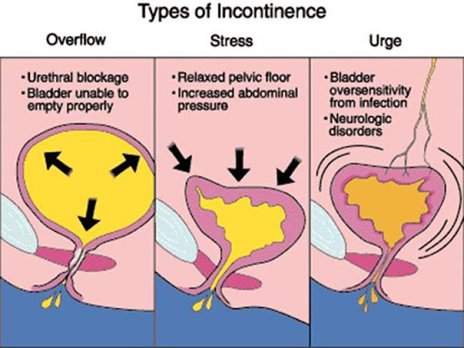
Types of Incontinence

Slide 170
Medical management
Treatment may include gradual dilation of the narrowed area (with metal sounds or boogies) or surgery (internal urethrotomy).
If the stricture prevents the passage of a catheter, the urologist uses several small filiform bougies in search of the opening. When one bougie passes beyond the stricture into the bladder, it is fixed in place, and urine drains from the bladder.

Slide 171
Mnx. Cont.
The opening then can be dilated, by passing a larger sound (a dilating instrument), with the filiform then acting as a guide.
After dilation, hot sitz baths and non-opioid analgesic agents are administered to control pain.
Antibiotic medications are prescribed for several days after dilation to prevent infection.
Surgical excision or urethroplasty may be necessary for severe cases.

Slide 172
Cont.
A suprapubic cystostomy may be necessary in some patients.
Research studies using the diode laser to treat urethral strictures suggest that it is safe and reliable, especially as the first line of treatment

Slide 173
ACUTE CYSTITIS
Cystitis is an infection of the bladder and urethra that affects mainly women and girls of 2 years if age.
Causative pathogen
Escherichia Coli is the pathogen in 70-95% of cases
Other pathogens include:
Protease mirabilis
Ersterococcus
Klebsiell SPP
And in young women S Saprophyticus

Slide 174
Clinical Features
Pain on urination and pollakiuria
(passing of small quantities of urine more frequently than normal)
In children, crying when passing urine
No fever
No flank pain, no systemic signs and symptoms in children
It is essential to rule out pyelonephritis

Slide 175
Diagnosis
Urine dipstick test – perform dipstick analysis for nitrates- indicate presence of enterobacteria
Leukocytes- (indicate inflammation) in urine
Microscopy/ culture and sensitivity to identify the causative pathogen
When not feasible administer empirical antibiotic where urinary schistosomiasis is endemic.
Consider schistosomiasis in pts with macroscopic haematuria or microscopic haematuria

Slide 176
Treatment
Cystitis in girls 2 years or above
Cefixime p.o. 8mg/kg once daily x 3 days or amoxicillin / clavulanic acid p.o. 45- 50mg kh/day in two divided doses x 3/7
Cystitis in non-pregnant women
If dipstick analysis to +ve for nitrates and leukocytes- Cipro-floxacin pp. 500mg/day in two divided doses * 3/7
OR Nitrofurantoin p.o. 300mg/day in 3 divided doses

Slide 177
Rx Cont.
Whatever antibiotics used symptoms may persist for 2 to 3 days despite adequate Rx
In event of Rx failure (or recurrent cystitis i.e. greater than 3-4 episodes per year)
Ciprofloxacin P.O. 1gm/ day in two divided doses x 5/7

Slide 178
For pts with recurrent cystitis consider
Bladder stones
Urinary schistosomiasis
Urinary tuberculosis
Gonorrhoea (examine partner)

Slide 179
HYPOSPADIAS

Slide 180
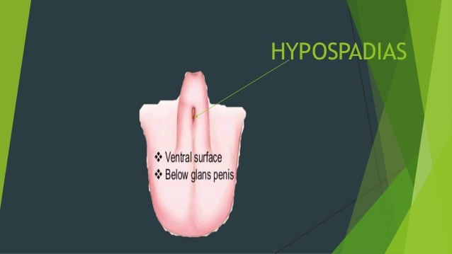
Hypospadias

Slide 181
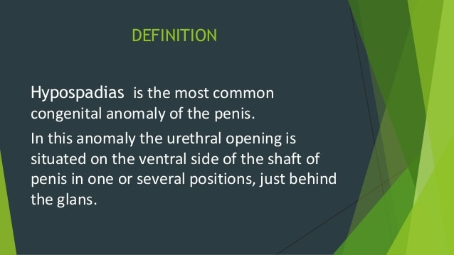

Slide 182
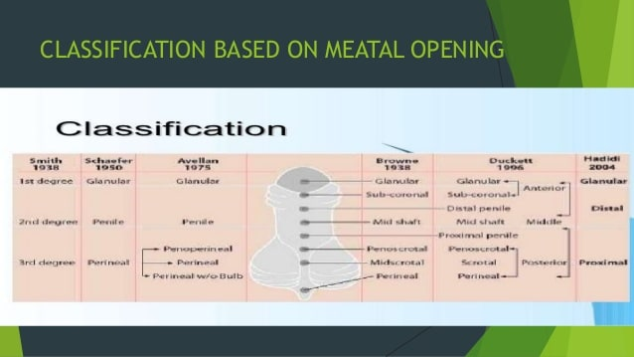

Slide 183
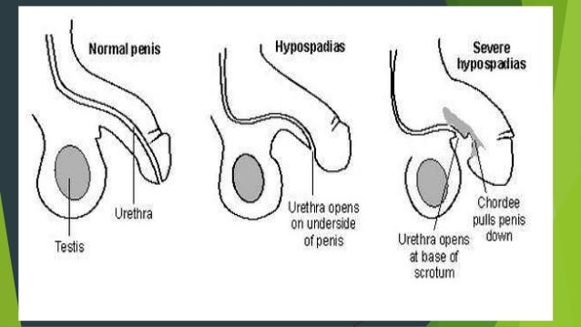

Slide 184


Slide 185
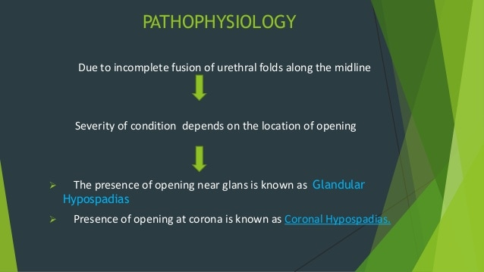

Slide 186
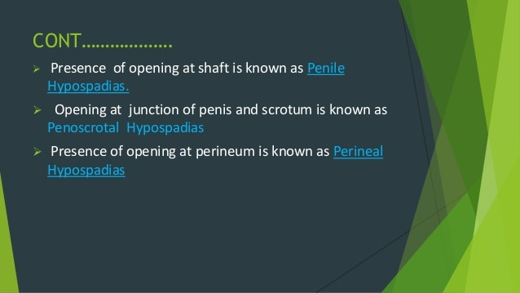

Slide 187
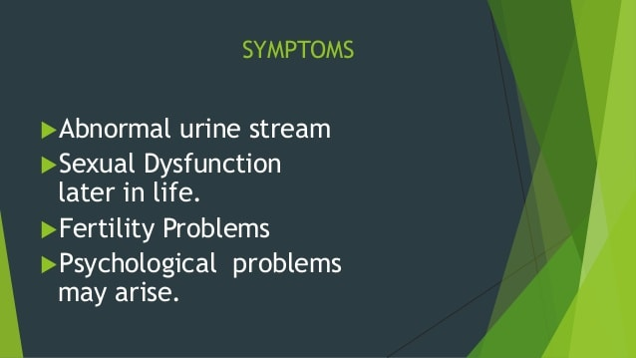

Slide 188
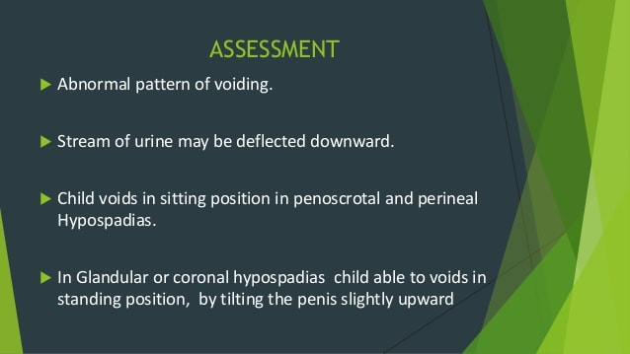

Slide 189


Slide 190


Slide 191
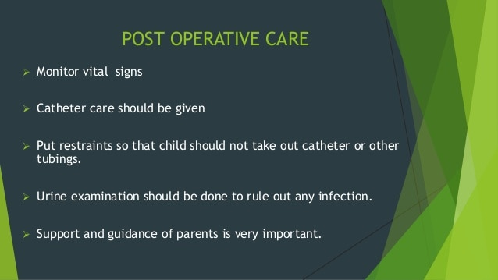

Slide 192


Slide 193
EPISPADIAS

Slide 194
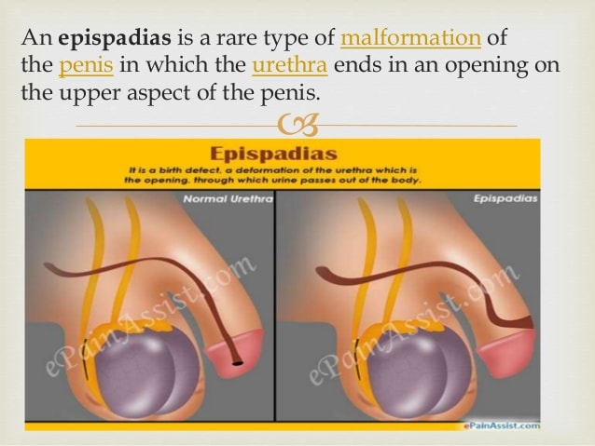

Slide 195
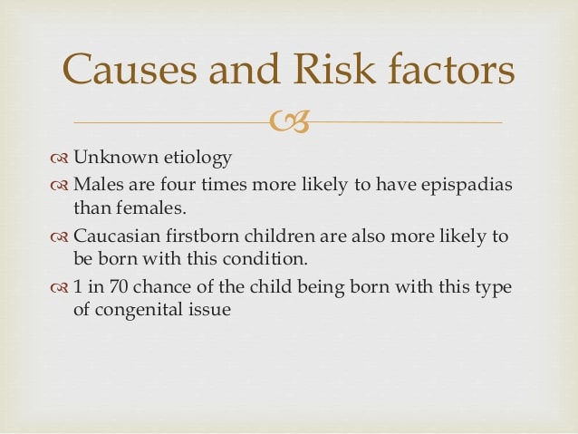

Slide 196
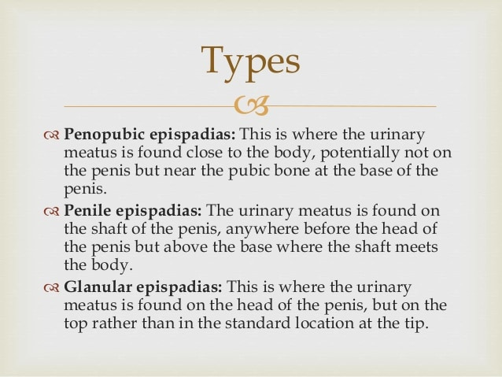

Slide 197
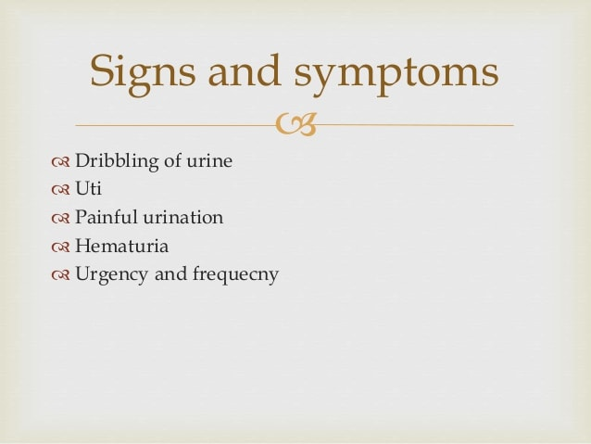

Slide 198
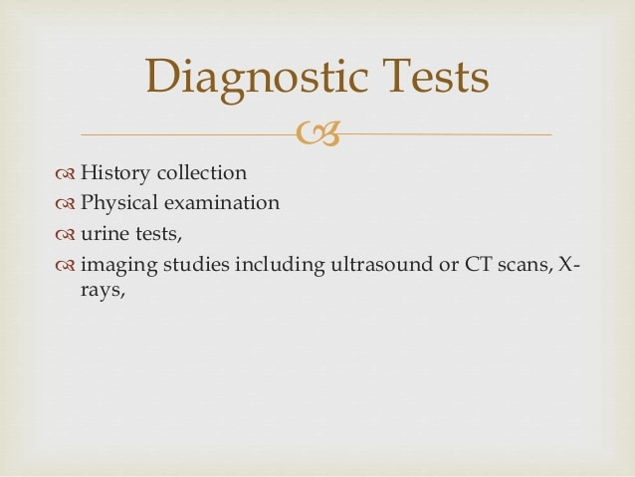

Slide 199
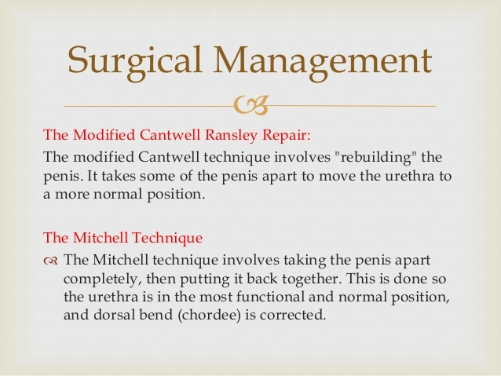

Slide 200
UROLITHIASIS AND NEPHROLITHIASIS

Slide 201
Urolithiasis and nephrolithiasis refer to stones (calculi) in the urinary tract and kidney, respectively.
Urinary stones account for more than 320,000 hospital admissions each year.
The occurrence of urinary stones occurs predominantly in the third to fifth decades of life and affects men more than women. About half of patients with a single renal stone have another episode

Slide 202
Pathophysiology
Stones are formed in the urinary tract when urinary concentrations of substances such as calcium oxalate, calcium phosphate, and uric acid increase.
Referred to as super-saturation, this is dependent on the amount of the substance, ionic strength, and pH of the urine.

Slide 203
Cont.
Stones may be found anywhere from the kidney to the bladder and may vary in size from minute granular deposits, called sand or gravel, to bladder stones as large as an orange.

Slide 204
Cont.
Stone formation is not clearly understood, and there are a number of theories about their causes.
One theory is that there is a deficiency of substances that normally prevent crystallization in the urine, such as citrate, magnesium, nephrocalcin, and uropontin.
Another theory relates to fluid volume status of the patient
Notes:
. Another theory relates to fluid volume status of the patien

Slide 205
anatomic derangements such as polycystic kidney disease, horseshoe kidneys, chronic strictures, and medullary sponge disease.
Urinary stone formation can occur in patients with inflammatory bowel disease and in those with an ileostomy or bowel resection because these patients absorb more oxalate.
Medications known to cause stones in some patients include antacids, acetazolamide (Diamox), vitamin D, laxatives, and high doses of aspirin.
However, in many patients, no cause may be found.

Slide 206
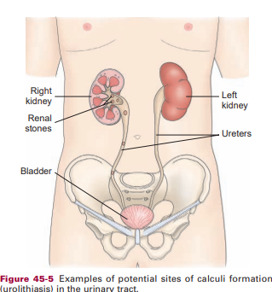
Potential sites of Calculi formation

Slide 207
Clinical Manifestations
Signs and symptoms of stones in the urinary system depend on the presence of
Obstruction,
Infection
Oedema.
When stones block the flow of urine, obstruction develops, producing an increase in hydrostatic pressure and distending the renal pelvis and proximal ureter.

Slide 208
Cont.
Infection (pyelonephritis and UTI with chills, fever, and frequency) can be a contributing factor with struvite stones.
Some stones cause few, if any, symptoms while slowly destroying the functional units (nephrons) of the kidney;
others cause excruciating pain and discomfort

Slide 209
Stones in the renal pelvis may be associated with an intense, deep ache in the costovertebral region.
Haematuria is often present;
pyuria may also be noted.
Pain originating in the renal area radiates anteriorly and downward toward the bladder in the female and toward the testis in the male.

Slide 210
If the pain suddenly becomes acute, with tenderness over the costovertebral area, and nausea and vomiting appear, the patient is having an episode of renal colic.
Diarrhoea and abdominal discomfort may occur.
These GI symptoms are due to reno-intestinal reflexes and the anatomic proximity of the kidneys to the stomach, pancreas, and large intestine

Slide 211
Stones lodged in the ureter (ureteral obstruction) cause acute, excruciating, colicky, wavelike pain, radiating down the thigh and to the genitalia.
Often, the patient has a desire to void, but little urine is passed, and it usually contains blood because of the abrasive action of the stone.
This group of symptoms is called ureteral colic.

Slide 212
Colic is mediated by prostaglandin E, a substance that increases ureteral contractility and renal blood flow and that leads to increased intra-ureteral pressure and pain.
The patient spontaneously passes stones 0.5 to 1 cm in diameter.
Stones larger than 1 cm in diameter usually must be removed or fragmented (broken up by lithotripsy) so that they can be removed or passed spontaneously

Slide 213
Cont.
Stones lodged in the bladder usually produce symptoms of irritation and may be associated with UTI and haematuria.
If the stone obstructs the bladder neck, urinary retention occurs. If infection is associated with a stone, the condition is far more serious, with urosepsis threatening the patient’s life.

Slide 214
Assessment and Diagnostic Findings
The diagnosis is confirmed by x-rays of the kidneys, ureters, and bladder (KUB)
by ultrasonography,
IV urography, or retrograde pyelography.
Blood chemistries and a 24-hour urine test for measurement of calcium, uric acid, creatinine, sodium, pH, and total volume are part of the diagnostic workup.

Slide 215
Cont.
Dietary and medication histories
Family history of renal stones are obtained to identify factors predisposing the patient to the formation of stones.

Slide 216
When stones are recovered (stones may be freely passed by the patient or removed through special procedures),
Chemical analysis is carried out to determine their composition.
Stone analysis can provide a clear indication of the underlying disorder.

Slide 217
For example, calcium oxalate or calcium phosphate stones usually indicate disorders of oxalate or calcium metabolism,
whereas urate stones suggest a disturbance in uric acid metabolism

Slide 218
Medical Management
The goals of management are to:
Eradicate the stone
determine the stone type
prevent nephron destruction
control infection
relieve any obstruction that may be present.

Slide 219
Cont.
This increases the hydrostatic pressure behind the stone, assisting it in its downward passage.
A high, around-the-clock fluid intake reduces the concentration of urinary crystalloids, dilutes the urine, and ensures a high urine output.

Slide 220
Cont.
The immediate objective of treatment of renal or ureteral colic is to relieve the pain until its cause can be eliminated.
Opioid analgesic agents are administered to prevent shock and syncope that may result from the excruciating pain.
Nonsteroidal anti-inflammatory drugs (NSAIDs) are effective in treating renal stone pain because they provide specific pain relief.

Slide 221
They also inhibit the synthesis of prostaglandin E, reducing swelling and facilitating passage of the stone.
Generally once the stone has passed, the pain is relieved.
Hot baths or moist heat to the flank areas may also be helpful.
Unless the patient is vomiting or has heart failure or any other condition requiring fluid restriction, fluids are encouraged.

Slide 222
Nutritional Therapy
Nutritional therapy plays an important role in preventing renal stone
Fluid intake is the mainstay of most medical therapy for renal stones.

Slide 223
Preventing Kidney Stones
Avoid protein intake; usually protein is restricted to 60 g/day to decrease urinary excretion of calcium and uric acid.
• A sodium intake of 3 to 4 g/day is recommended. Table salt and high-sodium foods should be reduced, because sodium competes with calcium for reabsorption in the kidneys.

Slide 224
Pt. education/Prevention
• Low-calcium diets are not generally recommended, except for true absorptive hypercalciuria.
Evidence shows that limiting calcium, especially in women, can lead to osteoporosis and does not prevent renal stones.
• Avoid intake of oxalate-containing foods (eg, spinach, strawberries, rhubarb, tea, peanuts, wheat bran

Slide 225
Cont.
Unless fluids are contraindicated, patients with renal stones should drink eight to ten 8-ounce glasses of water daily or have IV fluids prescribed to keep the urine dilute.
A urine output exceeding 2 L/day is advisable

Slide 226
Cont.
• During the day, drink fluids (ideally water) every 1 to 2 hours.
• Drink two glasses of water at bedtime and an additional glass at each night time awakening to prevent urine from becoming too concentrated during the night.
• Avoid activities leading to sudden increases in environmental temperatures that may cause excessive sweating and dehydration.
• Contact your primary health care provider at the first sign of a urinary tract infection.

Slide 227
Calcium Stones
Medications such as ammonium chloride may be used, and if increased parathormone production (resulting in increased serum calcium levels in blood and urine) is a factor in the formation of stones, therapy with thiazide diuretics may be beneficial in reducing the calcium loss in the urine and lowering the elevated parathormone levels.

Slide 228
Uric Acid Stones
For uric acid stones, the patient is placed on a low-purine diet to reduce the excretion of uric acid in the urine.
Foods high in purine (shellfish, anchovies, asparagus, mushrooms, and organ meats) are avoided, and other proteins may be limited.
Allopurinol (Zyloprim) may be prescribed to reduce serum acid levels and urinary acid excretion

Slide 229
Cystine Stones
A low-protein diet is prescribed, the urine is alkalinized, and fluid intake is increased.
Oxalate Stones
A dilute urine is maintained and the intake of oxalate is limited. Many foods contain oxalate
Foods that increase the urinary excretion of oxalate. These include spinach, strawberries, rhubarb, chocolate, tea, peanuts, and wheat bran

Slide 230
Interventional Procedures
If the stone does not pass spontaneously or if complications occur, common interventions include endoscopic or other procedures. For example,
Ureteroscopy,
extracorporeal shock wave lithotripsy (ESWL), or
Endourologic (percutaneous) stone removal may be necessary

Slide 231
Cont.
Ureteroscopy involves first visualizing the stone and then destroying it.
Access to the stone is accomplished by inserting a ureteroscope into the ureter and then inserting a laser, electrohydraulic lithotriptor, or ultrasound device through the ureteroscope to fragment and remove the stones.
A stent may be inserted and left in place for 48 hours or more after the procedure to keep the ureter

Slide 232
Cont.
ESWL is a non-invasive procedure used to break up stones in the calyx of the kidney.
After the stones are fragmented to the size of grains of sand, the remnants of the stones are spontaneously voided.
In ESWL, a high-energy amplitude of pressure, or shock wave, is generated by the abrupt release of energy and transmitted through water and soft tissues.

Slide 233
Cont.
When the shock wave encounters a substance of different intensity (a renal stone), a compression wave causes the surface of the stone to fragment.
Repeated shock waves focused on the stone eventually reduce it to many small pieces that are excreted in the urine.

Slide 234
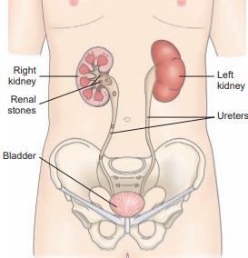
Potential sites for Urolithiasis in the Urinary tract

Slide 235
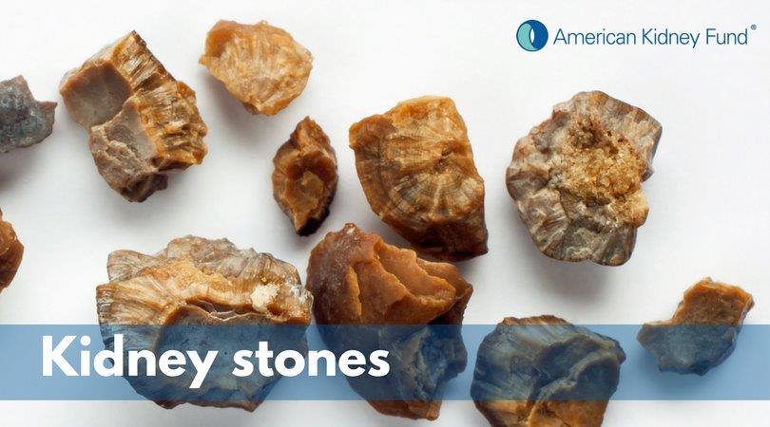
Renal Stones

Slide 236
Endourologic methods of stone removal
may be used to extract renal calculi that cannot be removed by other procedures.
A percutaneous nephrostomy or a percutaneous nephrolithotomy (which are similar procedures) may be performed.
A nephroscope is introduced through a percutaneous route into the renal parenchyma

Slide 237
Electrohydraulic lithotripsy
is a similar method in which an electrical discharge is used to create a hydraulic shock wave to break up the stone.
A probe is passed through the cystoscope, and the tip of the lithotriptor is placed near the stone.
The strength of the discharge and pulse frequency can be varied. This procedure is performed under topical anesthesia.

Slide 238
Cont.
After the stone is extracted, the percutaneous nephrostomy tube is left in place for a time to ensure that the ureter is not obstructed by oedema or blood clots.
The most common complications are
Haemorrhage
Infection
urinary extravasation. After the tube is removed, the nephrostomy tract usually closes spontaneously

Slide 239
Chemolysis
Stone dissolution using infusions of chemical solutions (eg, alkylating agents, acidifying agents) for the purpose of dissolving the stone, is an alternative treatment sometimes used in patients who are at risk for complications with other types of therapy, or who have stones (struvite) that dissolve easily.
A percutaneous nephrostomy is performed, and the warm chemical solution is allowed to flow continuously onto the stone. The solution exits the renal collecting system by means of the ureter or the nephrostomy tube.

Slide 240
Surgical Management
Was the major mode of therapy before the advent of lithotripsy. However, today, surgery is performed in only 1% to 2% of patients.
Surgical intervention is indicated if the stone does not respond to other forms of treatment.
It may also be performed to correct anatomic abnormalities within the kidney to improve urinary drainage.

Slide 241
Cont.
If the stone is in the kidney, the surgery performed may be a nephrolithotomy (incision into the kidney with removal of the stone)
Nephrectomy, if the kidney is non-functional secondary to infection or hydronephrosis.
Stones in the kidney pelvis are removed by a pyelolithotomy
those in the ureter by ureterolithotomy
those in the bladder by cystotomy

Slide 242
NURSING PROCESS THE: PATIENT WITH KIDNEY STONES
Assessment
The patient with suspected renal stones is assessed for
pain and discomfort
Nausea
Vomiting
Diarrhoea
abdominal distention.

Slide 243
Cont.
The severity and location of pain are determined, along with any radiation of the pain.
Nursing assessment also includes observing for signs and symptoms of
UTI (chills, fever, frequency, and hesitancy)
obstruction (frequent urination of small amounts, oliguria, or anuria).
The urine is inspected for blood and is strained for stones or gravel.

Slide 244
Cont.
The history focuses on factors that predispose the patient to urinary tract stones or that may have precipitated the current episode of renal or ureteral colic.
The patient’s knowledge about renal stones and measures to prevent their occurrence or recurrence is also assessed.

Slide 245
Diagnosis Nursing Diagnoses Based on the assessment data
The nursing diagnoses in the patient with renal stones may include the following:
• Acute pain related to inflammation, obstruction, and abrasion of the urinary tract
• Deficient knowledge regarding prevention of recurrence of renal stones

Slide 246
Cont.
Collaborative Problems/Potential Complications Based on assessment data,
potential complications that may develop include the following:
• Infection and urosepsis (from UTI and pyelonephritis)
• Obstruction of the urinary tract by a stone or oedema with subsequent acute renal failure

Slide 247
Planning and Goals
The major goals for the patient may include
relief of pain and discomfort,
prevention of recurrence of renal stones
and absence of complications.

Slide 248
Nursing Interventions
Relieving Pain
Severe acute pain is often the presenting symptom of a patient with renal and urinary calculi and requires immediate attention.
Opioid analgesic agents (IV or intramuscular) may be prescribed and administered to provide rapid relief along with an IV NSAID.
The patient is encouraged and assisted to assume a position of comfort

Slide 249
If activity brings pain relief, the patient is assisted to ambulate.
The pain level is monitored closely, and an increase in severity is reported promptly to the physician so that relief can be provided and additional treatment initiated

Slide 250
Monitoring and Managing Potential Complications
Increased fluid intake is encouraged to prevent dehydration and increase hydrostatic pressure within the urinary tract to promote passage of the stone.
If the patient cannot take adequate fluids orally, IV fluids are prescribed.
The total urine output and patterns of voiding are monitored.
Ambulation is encouraged as a means of moving the stone through the urinary tract.

Slide 251
Cont.
Renal stones increase the risk of:
infection
Sepsis
obstruction of the urinary tract

Slide 252
Cont.
The patient is instructed to report:
decreased urine volume
bloody or cloudy urine
Fever
and pain

Slide 253
Cont.
Patients with calculi require frequent nursing observation to detect the spontaneous passage of a stone.
The patient is instructed to immediately report any sudden increases in pain intensity because of the possibility of a stone fragment obstructing a ureter.
Vital signs, including temperature, are monitored closely to detect early signs of infection.

Slide 254
Cont.
UTIs may be associated with renal stones due to an obstruction from the stone or from the stone itself.
All infections should be treated with the appropriate antibiotic agent before efforts are made to dissolve the stone.

Slide 255
Promoting Home and Community-Based Care
Because the risk of recurring renal stones is high, the nurse provides education about the causes of kidney stones and recommendations to prevent their recurrence.
The patient is encouraged to follow a regimen to avoid further stone formation, including maintaining a high fluid intake because stones form more readily in concentrated urine.

Slide 256
A patient who has shown a tendency to form stones should drink enough fluid to excrete greater than 2000 mL (preferably 3000 to 4000 mL) of urine every 24 hours.
Urine cultures may be performed every 1 to 2 months the first year and periodically thereafter.

Slide 257
Cont.
Recurrent UTI is treated vigorously.
Because prolonged immobilization slows renal drainage and alters calcium metabolism, increased mobility is encouraged whenever possible.
In addition, excessive ingestion of vitamins (especially vitamin D) and minerals is discouraged.

Slide 258
Evaluation
Expected Patient Outcomes
Reports relief of pain
2. States increased knowledge of health-seeking behaviours to prevent recurrence
Consumes increased fluid intake (at least eight 8-ounce glasses of fluid per day)

Slide 259
Cont.
b) Participates in appropriate activity
c) Consumes diet prescribed to reduce dietary factors predisposing to stone formation
d) Recognizes symptoms (fever, chills, flank pain, haematuria) to be reported to health care provider

Slide 260
e) Monitors urinary pH as directed
f)Takes prescribed medication as directed to reduce stone formation
3. Experiences no complications
Reports no signs or symptoms of infection or urosepsis
Voids 200 to 400 mL per voiding of clear urine without evidence of bleeding
Experiences absence of urgency, frequency, and hesitancy
Maintains normal body temperature

